Slide 1
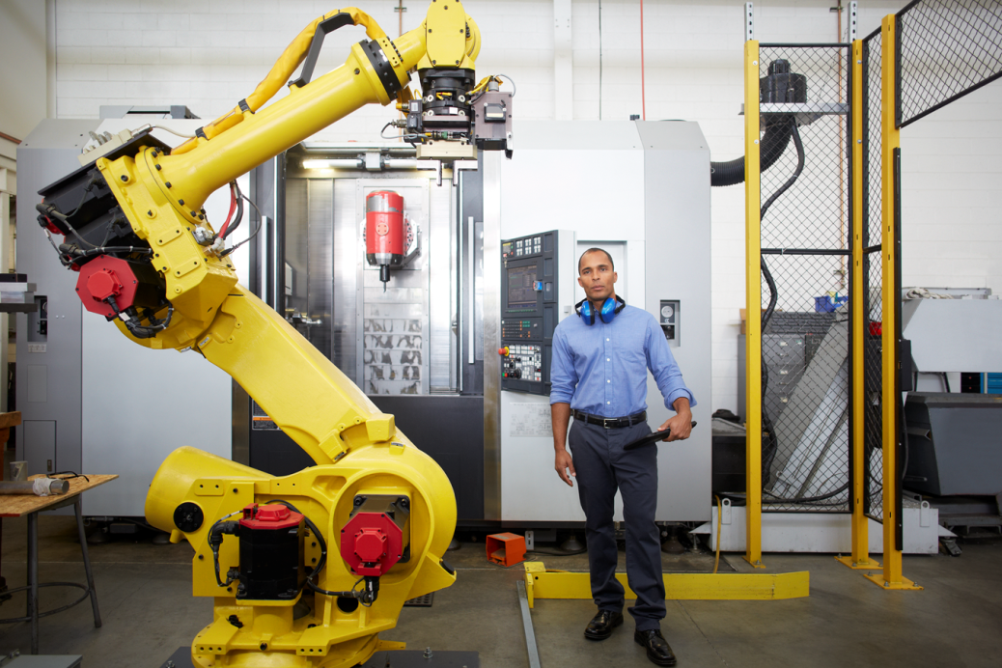
NW DISTRIBUTION CENTER
SAFETY TRAINING

Slide 2

Top 10 Safe Work Practices
You are responsible for your own safety and for the safety of others
All accidents are preventable
Do not take short cuts. Always follow the rules.
If you are not trained, don’t do it.
Use the right tools and equipment and use them the right way.
Assess the risks before you approach your work.
Do not indulge in horseplay while at work.
Practice good housekeeping.
Lock all equipment before stepping away.
Report all unsafe conditions.

Slide 3


Identifying suspicious activity
Every employee requires 2 badges at all times – 1 blue, 1 white
Do not tailgate other employees into the building
If you see an unidentified employee entering the building, there is a red phone located on each floor

Slide 4
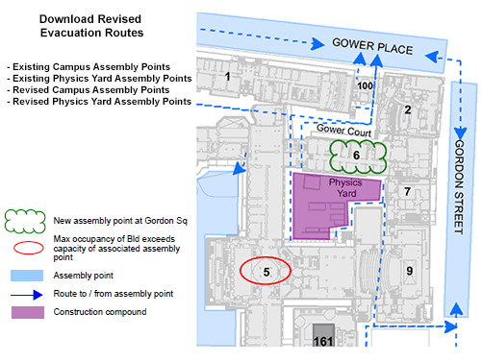
NW Distribution Center Emergency Route
These signs are posted next to the kitchen areas on each floor. Pay attention when evacuating the building for an emergency.

